Slide 1







WELCOME TO SEMINAR
Department of Computer Science and Engineering
Bhadrak Engineering School and Technology ( B.E.S.T)
Project Name – Lab Management System
Group Member’s Name -:
22-CS/02 – Abinash Panda
22-CS/12 – Om Prakash Behera
22-CS/22 – Sourav Sundar Pattanayak
22-CS/33 – Subharanshu Behera
Guided by –:
Er. Jyotsna mayee jena
er. Satabdi palit

Slide 2
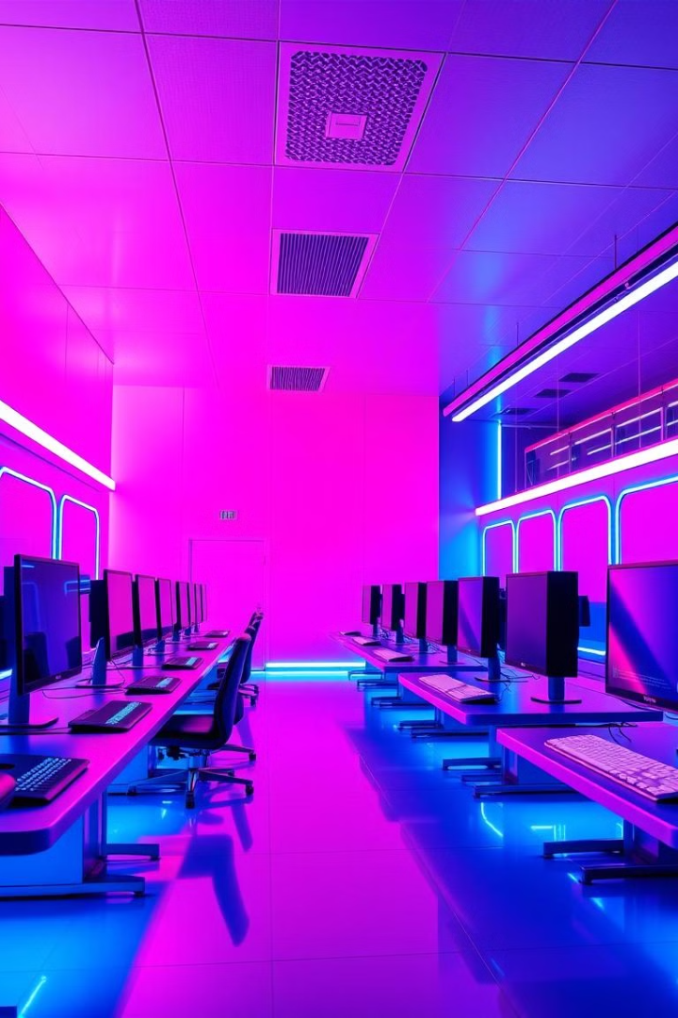
Lab Management System (LMS)
Ultimate Digital Lab Management System.
Empowering Learning Through Efficient Lab Management

Slide 3
Content
OBJECTIVES
INTRODUCTION
SOFTWARE AND HARDWARE REQUIREMENT
PROPOSED MODEL
ER DIAGRAM
DATA FLOW DIAGRAM
DEMO
ADVANTAGES
CONCLUSION
FUTURE SCOPE
ANY QUERY

Slide 4
Project Objectives
1
Efficient Resource Management
Optimize the allocation and utilization of lab resources.
2
Automated Inventory Tracking
Maintain real-time inventory of all devices and systems.
3
QR-Based Login & Profile
Enable secure and quick access with QR-based authentication.
4
Issue Tracking & Resolution
Streamline the process of reporting and resolving lab issues.

Slide 5
Introduction to the System
System Overview
Traditional Challenges
System Benefits
The Computer Lab Management System offers a centralized solution.
Manual management is often inefficient and prone to errors.
Our system addresses these issues with automation.
It aims to manage and monitor lab resources effectively.
It allows centralized control and improved security.

Slide 6

Software and Hardware Requirements
Software Requirements
Hardware Requirements
PHP version 8.3 , JavaScript Es4 or above
Minimum 4GB RAM
MySQL Database version 8.0 or latest
Minimum 10GB Storage
Bootstrap, PHPQRCODE Module
QR Scanner or webcam
XAMPP / Apache Server

Slide 7
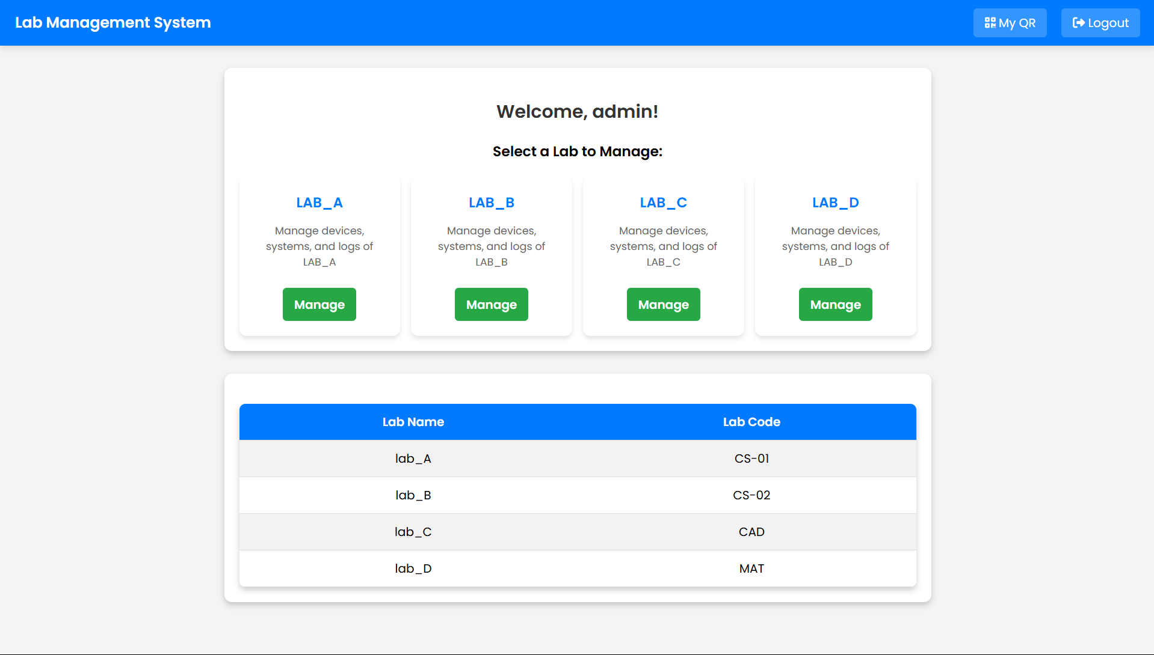




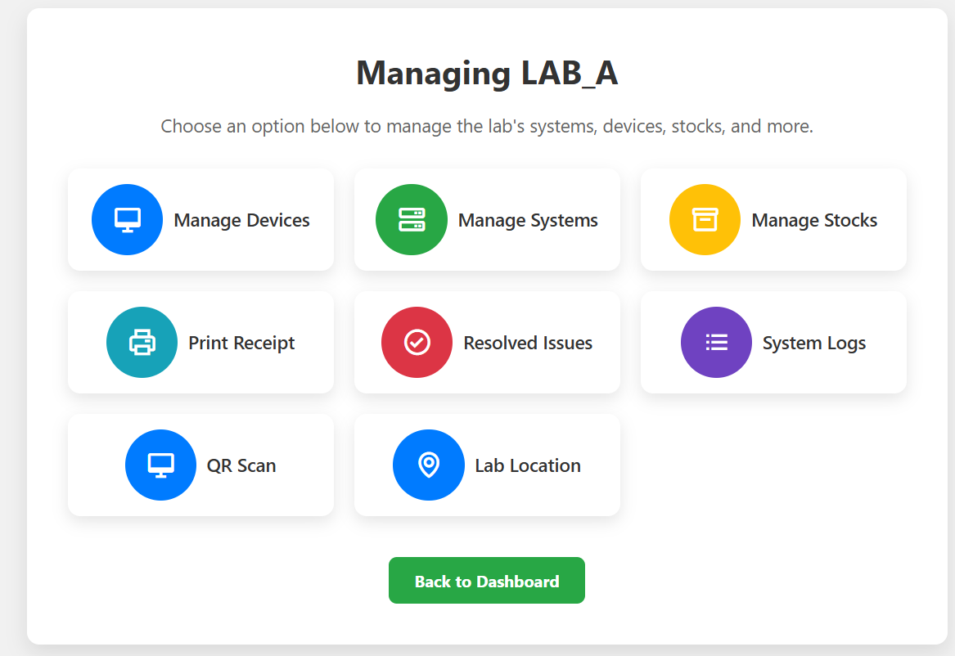

Proposed Model
Admin Dashboard
Manage labs, devices, and users with ease.
QR-Based Login
Secure and efficient login system.
Issue Tracking System
Report and resolve issues quickly.
Search Functionality
Find devices and stock efficiently.

Slide 8
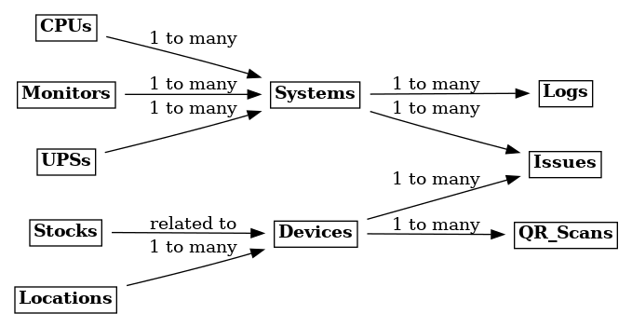
ER Diagram

Slide 9
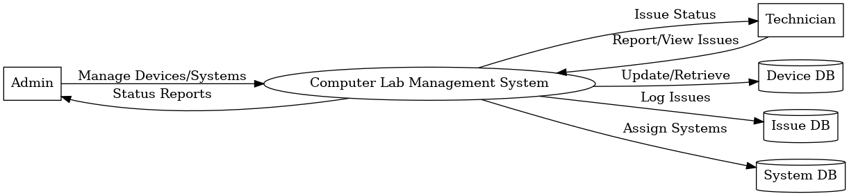
Data Flow Diagram
DFD Level -0
LMS
ADMIN
DFD Level -1

Slide 11






Advantages
Efficient Management
Automated Tracking
Faster Resolution
Enhanced Security
Digitally
Recorder
Reduces
Manual Errors

Slide 12



Conclusion
Simplified Resource Management
1
Efficiently manage lab resources.
Effective Tracking
2
Track devices in real-time.
Enhanced Security
3
Secure lab devices effectively.

Slide 13
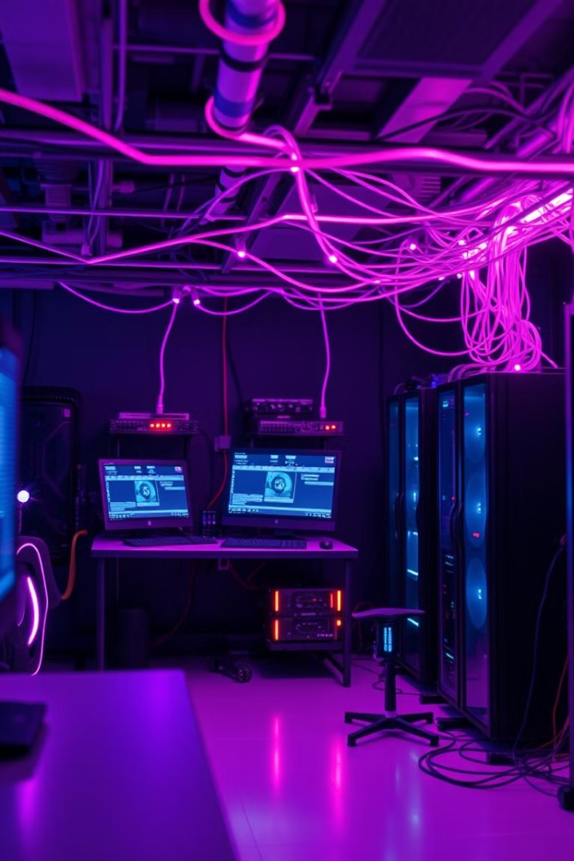
Future Scope
AI-Based Fault Detection
Implement AI for proactive issue detection.
Cloud Integration
Integrate cloud storage for lab reports.
Remote Monitoring
Enable remote maintenance alerts.

Slide 14
THANK YOU EVERYONE
LOVE
YOU
GUYS

